Slide 1
Software Analytics (Talk 3)
Joydeep(MT2013062) IIIT,Bangalore

Slide 2
Few software Analytics products in market
INTERSTAGE PROCESS ANALYTICS SOFTWARE by Fujitsu (http://www.fujitsu.com/global/Images/Fujitsu-Interstage-Process-Analytics-Factsheet.pdf)

Slide 3
Few software Analytics products in market
http://www.newrelic.com/
Monitor the impact of new releases beyond the performance of application response times — to the implications on the several other components of the application.
Share a dashboard with the development team to gain insight into deployment details and ownership — increasing overall transparency and communication.
Drill into deployment details such as the direct impact on CPU utilization, physical memory utilization, implications on database performance and instantly identify impact on throughput.
Notes:
http://newrelic.com/solutions/application-development

Slide 4
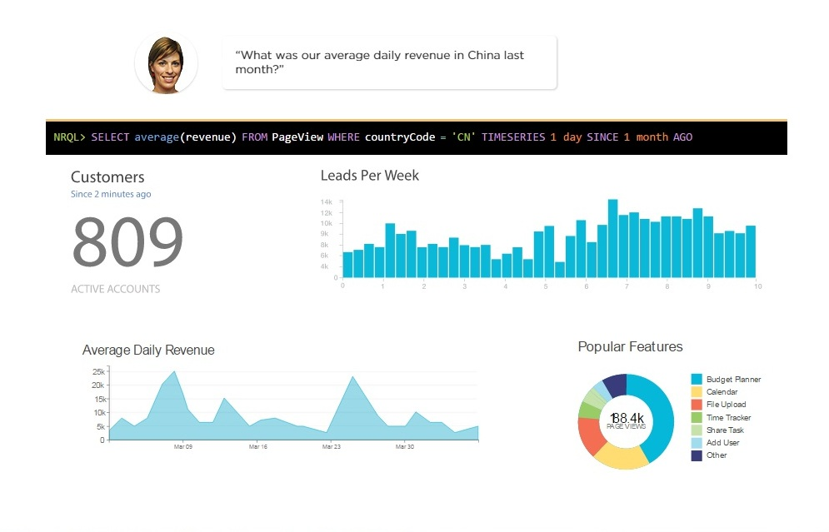
Glimpse

Slide 5
My experience
Dashboard reporting

Slide 6
About the paper
SQuAVisiT: A Software Quality Assessment and Visualisation Toolset
Serguei Roubtsov, Alexandru Telea, Danny Holten Department of Mathematics and Computer Science, Technische Universiteit Eindhoven Den Dolech 2, 5600MB, Eindhoven, the Netherlands

Slide 7
Cobol
COBOL is a compiled computer programming language designed for business use. It is imperative, procedural and, since 2002, object-oriented.
Software quality assessment of large COBOL industrial legacy systems, both for maintenance or migration purposes, mounts a serious challenge.

Slide 8
Abstract
SQuAVisiT : Software Quality Assessment and Visualization Toolset
It allows a fully automatic extraction of metrics, call information, and code duplication from COBOL source code. This information, stored into a database, can be easily converted and exported to a set of visualization tools.

Slide 9
Legacy COBOL systems usually contain millions of lines of code (LOC) spread over thousands of modules, developed by tens of people over many years, are often poorly documented and, to a large extent, knowledge about them is lost. Assessment of the code quality can help maintenance activities for such code.
A first step in quality assessment is typically the retrieval of structural and metric information, such as call graphs and source-level metrics.

Slide 10
Although many tools such as parsers and fact extractors exist for this, this is still a semi-automatic, delicate process. Besides, interpretation of the retrieved facts, such as tens of thousands of metrics and module interdependencies, is also difficult
Hence SQuAVisiT

Slide 11
has two subsystems: one for quality assessment and the other for visualization.
QuA : structured around a database which stores facts and metrics extracted
(Vis) subsystem couples the database with a number of visualisation tools, also loosely integrated as plug-ins.
Notes:
LOC, McCabe’s cyclomatic complexity, and call relations

Slide 12
TableVision : displays tables of hundreds of thousands of rows containing extraction metrics.
MatrixZoom : displays dependency (e.g. call graphs) and structural (e.g. system hierarchy) information using a matrix metaphor.
ExtraVis : displays the same dependency
GemX : displays code duplication.

Slide 13
Case study
COBOL legacy system of a large insurance fund
3 thousand modules,
1.7 million LOCs.
The system provides support for a variety of online requests and batch executions. The system is at the starting point of migration to a new, presumably Java-based business rules engine platform. At this point it is crucial to assess the existing system to decide which system artifacts, e.g. architecture, business rules or code, are reusable and which not, and what is the migration effort.

Slide 14
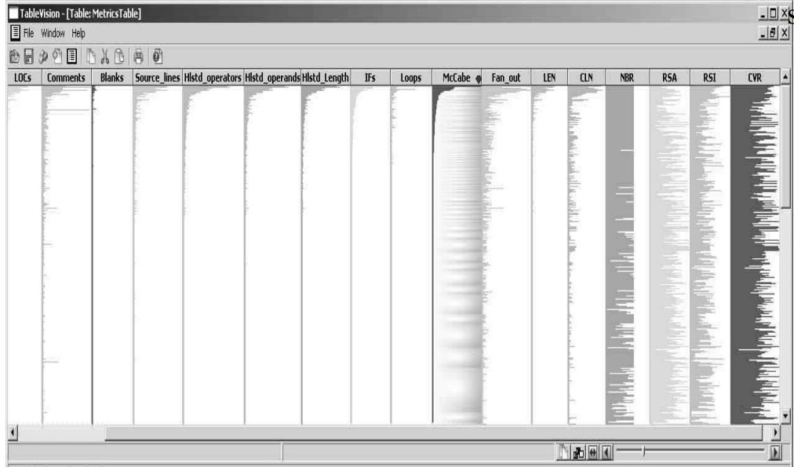
Every horizontal pixel line shows a different module, and every column a different metric.
Notes:
SQuaVisiT to parse, extract metrics and call relations from the entire system in under 30 minutes on an ordinary PC.

Slide 15
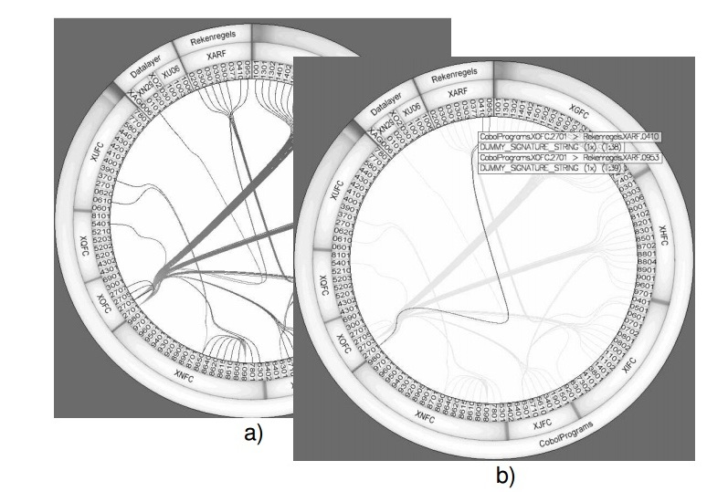
System Structure
Notes:
system structure, displayed as a set of concentric rings (functions, modules, layers from inside to outside) and the calls as hierarchically bundled curves

Slide 16
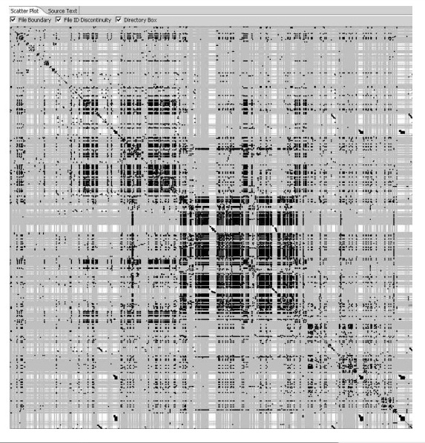
Code Duplication
Notes:
Black pixels denote code duplications

Slide 17
Conclusions
The modules are sorted on decreasing McCabe metric values. This help us locating the most complex (top) modules, which are less than 5% of the system
a high-level module called the ’Business-rules’ layer. This violates a main design decision saying that business-rules can be called from low levels only in order to make the system more maintainable
Widely spread black spots show code duplication

Slide 18
Technologies used
incorporated several such third-party tools for the visualization of call relations and system structure, and metrics visualization. These tools use novel visualization techniques such as bundled edges, matrix plots, and table lens
metrics extracted by a number of third-party plug-ins. One such plug-in is COBOL preprocessor and parser which also extracts basic facts, such as number of LOC, McCabe’s cyclomatic complexity, and call relations. Another plug-in integrates CCFinder, a state of the art code duplication detection tool.

Slide 19
Paper 2
Mining Email Social Networks∗
Christian Bird, Alex Gourley, Prem Devanbu, Michael Gertz Dept. of Computer Science, Kemper Hall, and Anand Swaminathan Graduate School of Management, University of California, Davis, Davis, California Republic. aswaminathan@ucdavis.edu

Slide 20
Introduction
Communication & Co-ordination activities are central to large software projects
Open Source Software
the email archives of OSS projects provide a useful trace of the communication and co-ordination activities of the participants.

Slide 21
Introduction…
The difficulty and intensity of the required coordination effort is quite high; this is often cited as the reason why adding more developers doesn’t necessarily speed-up development.
Every open-source project includes one or more public mailing lists wherein project stakeholders can communicate and coordinate their activities. The entire trace of these mailing lists are archived and available for study.
These archives, along with the versioned source code repositories and other on-line artifacts constitute a unique and valuable resource for the study of C&C activities in software projects.
Notes:
C&C activities influence the design, structure and evolution of software systems.

Slide 22
CHATTERERS & CHANGERS
Stories
Possibilities

Slide 23
Questions
• What are the properties of the social network of developers? • Are developers who send a lot of messages on the mailing list also very active in source code changes? • Do developers play a different role than non-developers in the social network? • Do the most active developers have the highest status among developers ?

Slide 24
Unmasking Aliases
From: "Bill Stoddard" reddrum@attglobal.net
Our first step in resolving aliases is to automatically crawl messages and extract all such headers to produce a list of < name, email > identifiers (IDs). Once this is done, we execute a clustering algorithm that measures the similarity between every pair of IDs.

Slide 25
2544 separate IDs
The clustering algorithm produced 1581 clusters. The largest of these had 70 members, the next biggest 55, and so on; finally, there were 163 doubles, and 1271 singletons.
Manual processing of the 1581 clusters produced 2012 distinct individuals, some of whom have many aliases.

Slide 26
Clustering algorithm
ID is a < name, email > tuple
The first step is create pairwise similarity measures for every pair of IDs. Two IDs with similarity measure exceeding an empirically set threshold are placed into the same cluster.
The similarity measure is computed by proceeding as follows:
Normalize name : remove all punctuation, suffixes (“jr”); turn all whitespace into a single space; remove generic terms like “admin”, “support”, from the name; split the name (using whitespace and commas as cues) into first name and last name.

Slide 27
Clustering Algorithm
Name Similarity: We use a scoring algorithm based on the Levenshtein edit distance between the full names, and the first and last names separately. We consider names similar if the full names are similar, or if both first and last names are similar.
Names-email Similarity: Two IDs are also scored highly similar if the emails and names match. If the email contains both first and last names (and the lengths of the names are at least 2 characters) we consider them matched.
Email Similarity: If the Levenshtein edit distance between two email address bases (not including the domain) is small, two emails are considered similar (as long as the two bases at least 3 characters long)
Cumulative ID similarity: The similarity between two IDs is the maximum of the 3 mentioned above.
Notes:
1. Andy Smith is similar to Andrew Smith, but Deepa Patel is dissimilar to Deepa Ratnaswamy.
2. Erin Bird matches erinb and ebird.

Slide 28
Data Extraction
email activity on the Apache HTTP Server Developer mailing list over a period starting in 1999 to the current date.
For every email, we extracted from the email header the message identifier, the sender, the sent time, and the identifier of the message (if any) to which this message was a reply.
1.3% of messages had malformed headers.

Slide 29
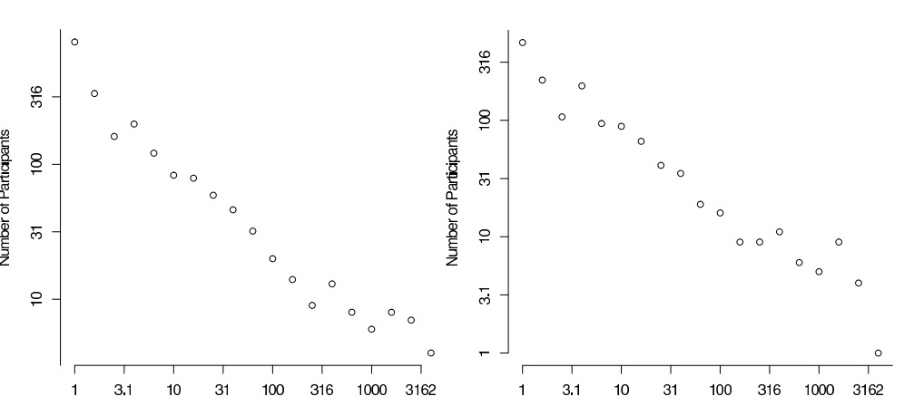
Data description
the distribution of people vs. number of messages they sent; and distribution of people vs. the number of reply messages they received.

Slide 30
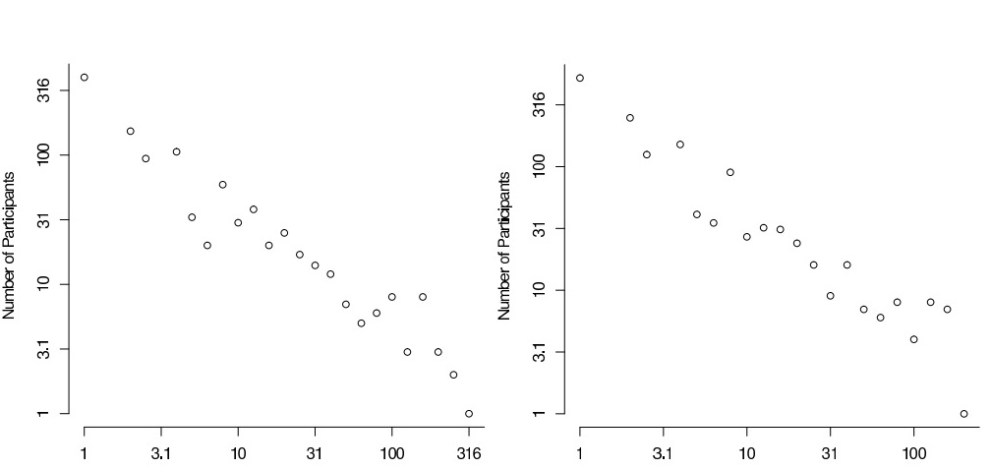
Data Description…
The out-degree in the social network; and the in-degree in the social network

Slide 31
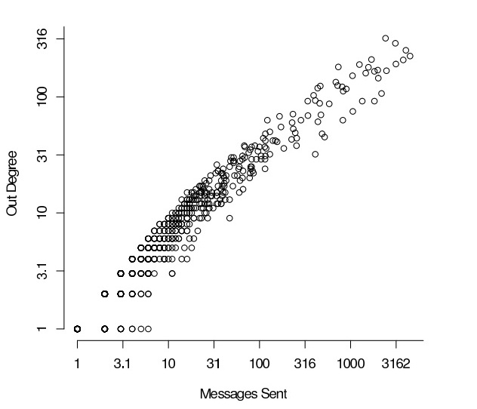
Data description
the relationship between the number of messages sent by an individual, and the number of distinct respondents who replied to that individual

Slide 32
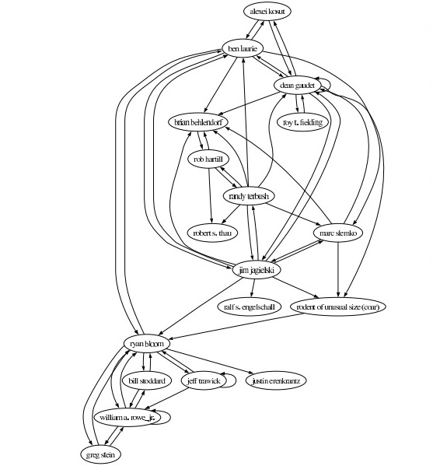
Notes:
a pruned email social network; the full network is too large to render in a useful fashion on non-interactive media. Each directional link in Figure 3 indicates a message count of at least 150

Slide 33
Insights And Actions
There are large number of correspondents on the mailing list who do not have commit privileges, never make any changes to the project files. These individuals tend to be less active on the email list.
Based on the data for just the 73 committers, we observe a Spearman’s rank correlation of about 0.80 between the number of messages sent by an individual, and number of source changes they make. This clearly indicates that the more software development work an individual does, the more C&C activity the individual must undertake

Slide 34
Social network measures
3 measures, in-degree out-degree and betweenness, which are indicators of the importance of an individual in a network.
High betweenness indicates that the person is a kind of broker, or gatekeeper in the social network; s/he plays a role in a great many interactions. Such people can have high status, and can also be bottlenecks.

Slide 35
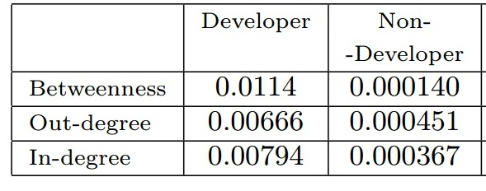
Questions
Are developers more likely to play the role of gatekeepers or brokers in the complete email social network?
They also indicate that developers have a significantly higher status

Slide 36
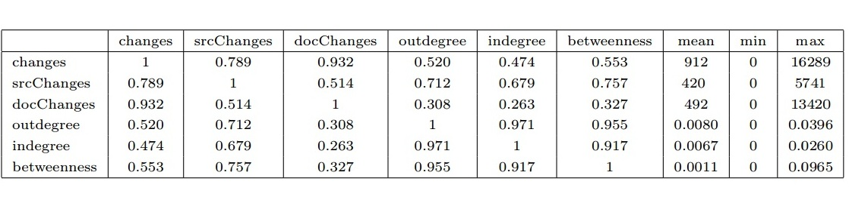
Notes:
The top 3 rows (left 3 columns) are measures of activity: total changes, source code changes, and document changes. The bottom 3 rows (columns 4,5, and 6) are indicators of social status
source changes are not as highly correlated with document changes
Turning now to the relative indicators of status, we can see that source changes shows the strongest rank correlationwith the social network status indicators of normalized out and in-degrees, and betweenness. This indicates that even within the higher-status group of developers, the most active developers play the strongest role of communicators, brokers, and gatekeepers.

Slide 37
Thank you

